Slide 1
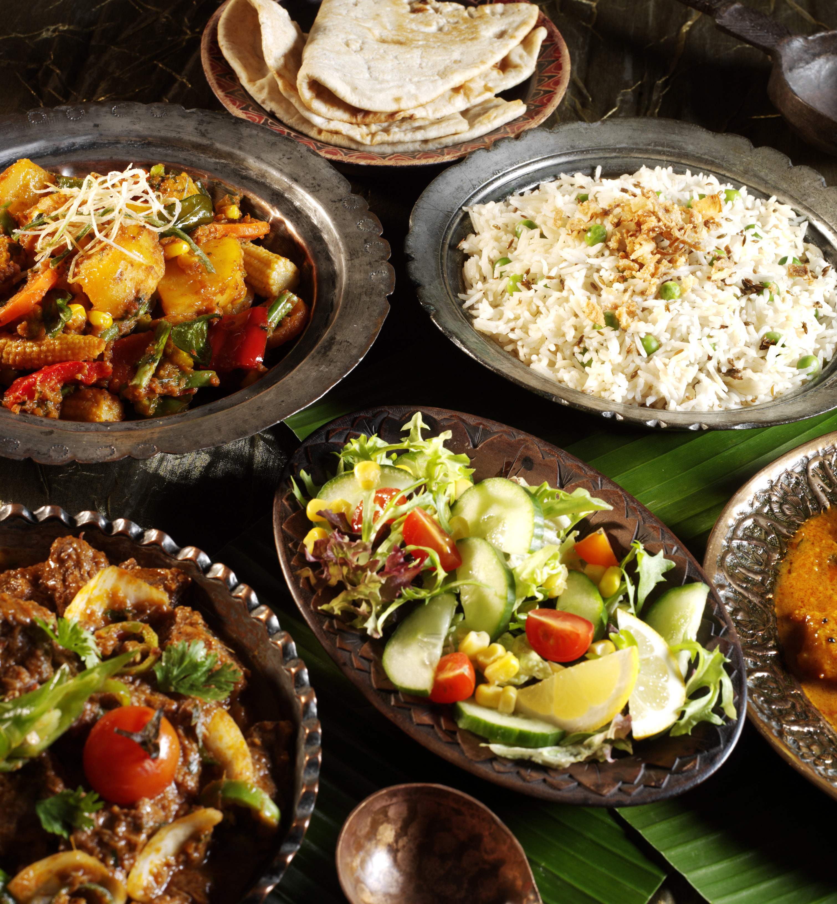

BDM CAPSTONE PROJECT
Maximizing Restaurant’s Online Success
Presented by – Mahi Mudgal
Roll No.-21f3002602

Slide 2
Organization background and the problem that they are facing.
Organization Background
Table of content
Details about data collected and method used in analysis.
Data collection and analysis
Visualization
Trends and insights coming out through visualizing data
Recommendation with practical implementation.
Recommendation and Expected Outcome

Slide 3
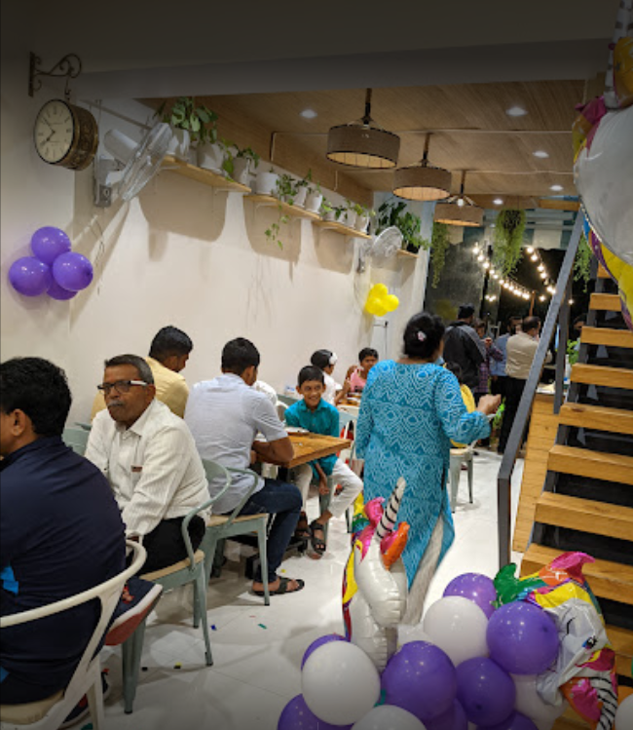

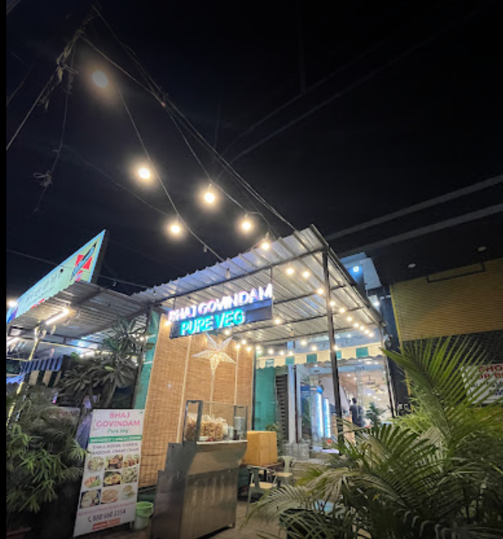
Organization Background and Problem Statement
Background
The Restaurant "Bhaj Govindam" located in Pune, having multiple outlet, running since 2020 successfully ,with an average sitting of 50 tables.
It is an B2C establishment known for offering delicious vegetarian food that provides a homely experience.
Problem facing in its online business :-
Not able to generate enough profit from online business.
Number of orders is less.
Offers and discount is random not backed by any analysis.
Lack of customer knowledge.

Slide 4



Data Analysis Methods
Data Cleaning:
Customer Segmentation
Cleans data using (find and replace, split, transpose, pivot/unpivot) to handle missing values, data type inconsistencies, and outliers. Connects tables with relationships (one-to-many, many-to-many). Duration: February 2024 to July 2024
Factors Impacting Orders
I conducted item analysis to identify best and worst-selling items, along with popular combos.
I compared current prices with market rates by collecting relevant data and also I analyzed customer feedback by identifying top recurring words.
I categorized customers using RFM analysis by calculating recency (last purchase date), frequency (number of purchases), and monetary value (total spending). These values were binned into a score range of 1-4, averaged, and used to create customer segments like Loyal, Champions and At-Risk.

Slide 5
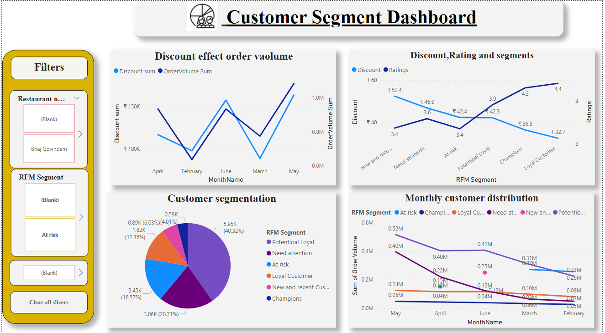
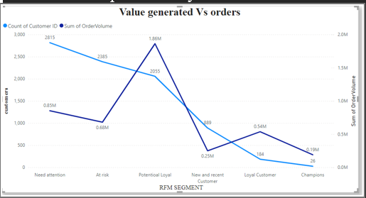
Discounts/offers:-As the discount price increases sales volume also increases. It indicates discount plays a crucial role in increasing sales volume sum.
Discount given in Wednesday is less. Increase Wednesday sales by offering a higher discount to boost orders and overall revenue.
Ratings:-Loyal customer including champion and potential loyal are highest contributor of restaurant visibility, as they give higher ratings which ultimately attracts more orders.
Customer segmentation:- Indicate that number of potential loyal customer is highest these customer have average RFM score. Number of loyal and champions are less.
Sales Distribution among customers: There is fluctuation in sales for every segment but loyal customers are consistent .
Conclusion Although there are fewer loyal customers, they contribute the most on average to sales, while potential loyal customers are the highest overall contributors.

Slide 6
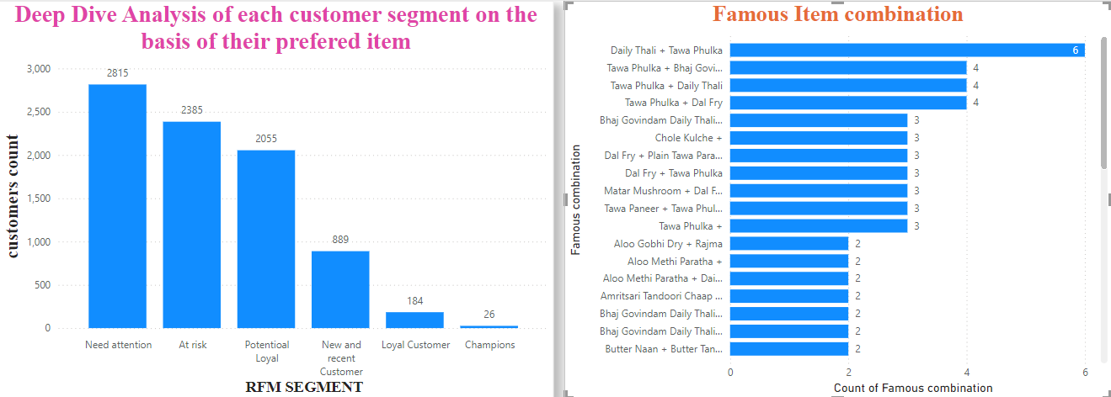
Item deep dive:-This graph indicate that number of need attention customer is highest and champions is lowest. But champions are contributing most. To increase these customer we can analyze their item preference so that we offer same to other new customers that too segregated based on different outlets help in finding best item and worst item of each restaurant.
combos:- These are the combos liked by champions. Majorly. liked combos can be added in menu list. Or can help in creating offers like buy one item and get offer on other. This help in making meaningful offers/discount and increase quality of menu which ultimately increase visibility and orders.

Slide 7
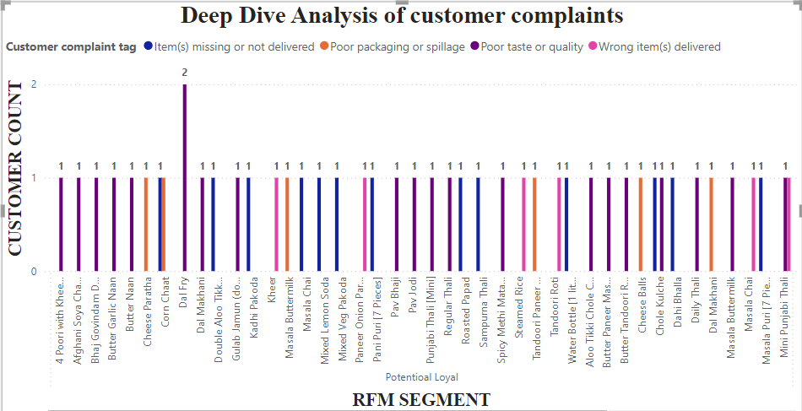
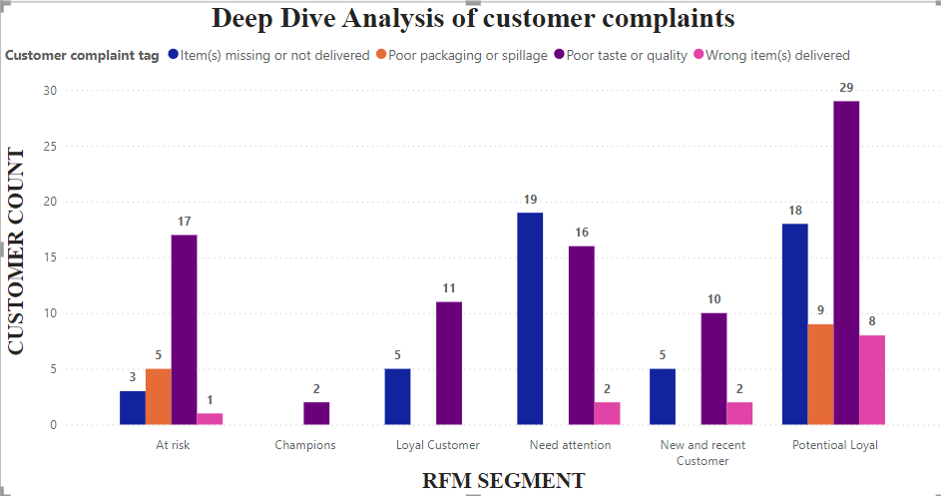
Complaints analysis findings.
Ex in potential loyal customers Dal fry is a famous item just need improving quality in Pind paratha.
Complaints analysis findings.
Buttermilk is having packaging complaints.
We can see similar analysis for all customer category. Using Power BI drill down

Slide 8
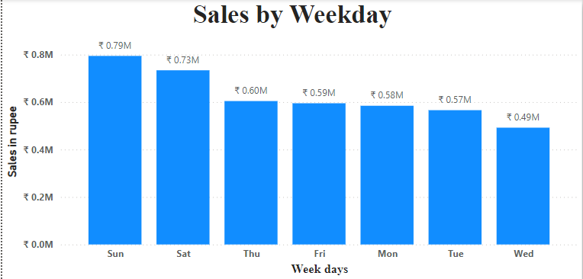
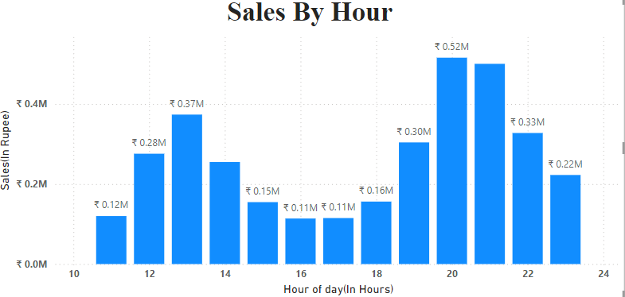
Ordering happens mostly at night.
Sunday is the most and Wednesday is least selling day.

Slide 9
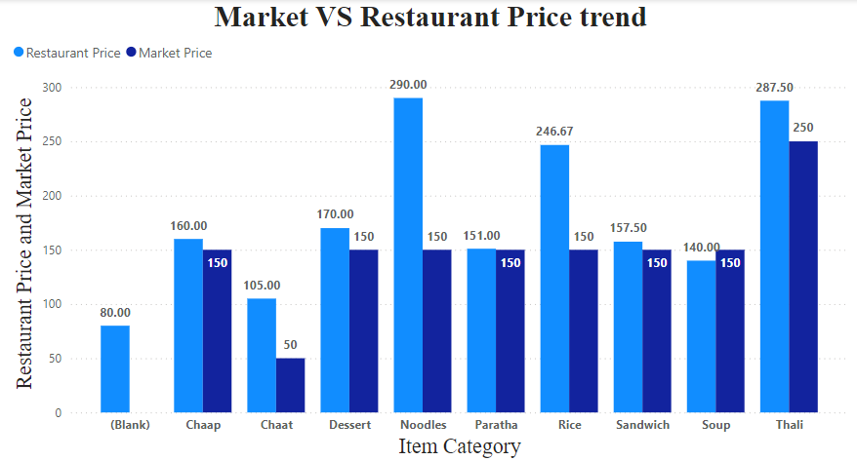
Huge Gap between Noodles restaurant and market rate.
Price is kind of major factor effecting visibility, But it should also according to budget. Hence need attention.

Slide 10
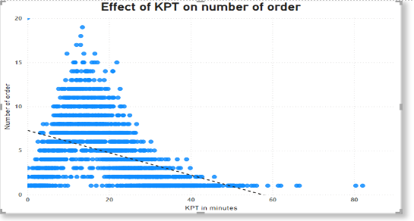
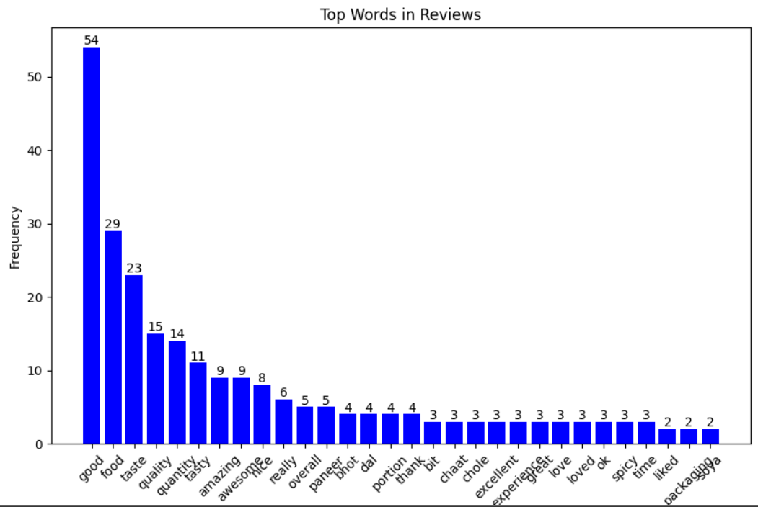
Increase in Kichen preparation time decrease order number.
Paneer ,chole and chaat are in good book of customer.

Slide 11




Recommendations
Discount/offers and promo issue.
Customer segmentation can significantly improve this area. Loyal customers, including potential loyal customers and champions, contribute the most to revenue, as findings show. The owner can offer special discounts to these customers through loyalty programs or by sending coupon codes like 'xyz' via email, offering x% off for their loyalty. This helps retain customers and encourages others to become loyal.
Similarly, for potential loyal and new customers, discounts can be offered on their next three purchases.
Famous Combos help manage discounts by identifying which items are likely to be bought together but might not be due to budget constraints. Offering deals on these items can increase sales.
Increasing number of orders.
KPT (Kitchen preparation time) - as we see more the KPT less number of orders. Decreasing this is must. For doing so we can utilize knowledge of customers peak time i.e.. Sunday and night time. Operational staff need to be either more at this time or need to be prepared for handling more orders during peak time.
Pricing – This need to be comparable to market to increase number of order specially for Noodles. Expenditure needs to be adjusted for achieving optimal price while maintaining profit.
Focus more on may month as it generate highest revenue.Start some offers in march as it genrate less revenue.
Increase wednesday sales by offering special discount on that day.
Customer awareness- complaints and reviews.
Identifying frequently sold items that often receive complaints, like Dal Fry, and improving them can boost sales while reducing complaints.
Refund amount given o packaging by owner is significant hence need to be addressed by assigning staff for same specially.Refund for wrong item dilivered taken by zomato hence need no attention.

